Slide 1
Wine Tasting Note Generator
A NLP Language Generation Model

Slide 2
Table of Contents
01
Problem Statement
05
Model Evaluations
02
Dataset Sources
06
Flask Deployment
03
Data Cleaning & EDA
07
Conclusions
04
Models Created

Slide 3
Problem Statement
- The average consumer still relies on wine tasting notes in decision making
- Wine tasting notes can be very individual with writers depending on personal experience and their own vocabulary
- The goal of the model is to create quick, relatable wine notes from a more standardized and common vocabulary of wine descriptors

Slide 4



Data Sources
Data was extracted from Tasting Notes from the following sources:
Wine Spectator Top 100 Wines
Wine Advocate/Robert Parker
Vinous
Scrapped over 80,000 Tasting Notes

Slide 5
DATA CLEANING
1. Remove Duplicates
Duplicate Tasting Notes that were likely input multiple times by accident
2. Clean Notes
Remove names, websites,
phone numbers
3. Preprocessing
4. Model Specific
End of Sentence tokens added
Data Set split into Xs and Ys
Removing Punctuation

Slide 6
Wine Note Length & Tasting Note Variation
Wine Note Lengths
Similar Wine Notes
Wine note lengths ranged from under 10 words to over 800 words
Short tasting notes were sometimes scores with a “Recommended” Tag for the note
Shorter notes under 25 words were cut to provide the model with notes of longer length, as well as to later be able to compare generated notes with ground truths based on an initial seed text
Long notes had many personal anecdotes and notes above 75 were cut
Wine notes that were similar but not duplicate fell into 2 categories:
Wine was named based on region with the same year
Similar tasting notes for wines of different vintages from the same winery
Both were ultimately kept as there was enough variation
48,000 rows of data remaining

Slide 7
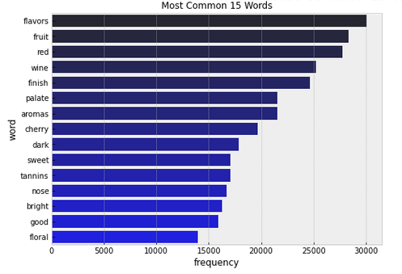
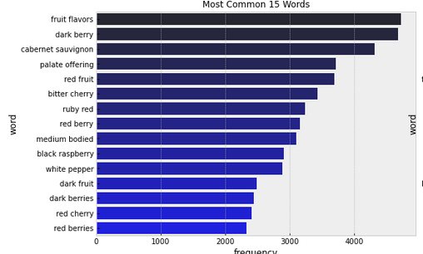
Top 25 Common N-Grams
Most Common Unigrams
Typical Descriptors are seen in the most common words, such as: flavours, fruit, wine, finish
Most Common Bigrams
Descriptors here are common phrases used in tasting notes but surprisingly favour red wines, perhaps representing a skew in the types of wines that are usually tasted

Slide 8
MODELS

Slide 9
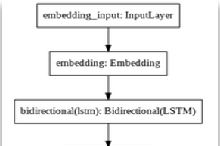


MODEL 1
“Most Basic Model” Dataset: Trained on Wine Spectator Data only ~About 2200 rows of data Topology: 2 LSTM layers stacked on each other Generated text: Aromatic and beautiful harmonious with black tea notes that are in good harmony supported by light tannins and prominent acidity offers a beautiful mouthfeel that coats the palate and invites you back for another sip drink now through 2027 500 cases imported

Slide 10
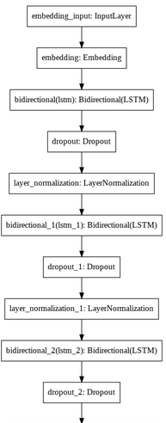

MODEL 2
Dataset: Trained on Wine Spectator Data only ~About 2200 rows of data Topology:
3x
LSTM
Dropout (0.1)
Normalisation
Generated text:
Aromatic and fresh with a savory that underscores well defined and plush another show finish drink now through 2027 5

Slide 11
MODEL 3
Dataset: Trained on the Entire Data Set ~About 48,000 rows of data Topology:
3x
LSTM
Dropout (0.1)
Normalisation
Generated text:

Slide 12
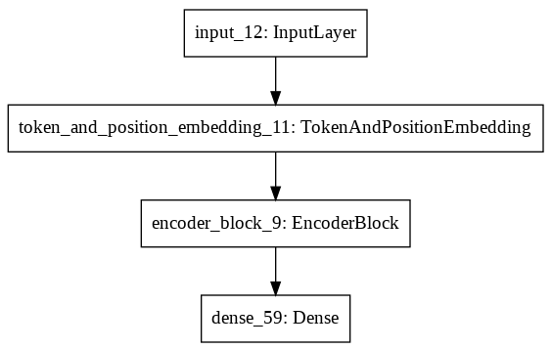
MODEL 4
Dataset: Trained on the Entire Data Set ~About 48,000 rows of data Topology:
Token Embedding
Positioning Embedding
4x Encoder Layers:
Multi Head Attention
Dropout
Normalisation
Feed Forward layer
Dropout
Normalisation
Generated text:
Aromatic and beautiful but the the the on good the and finishes dark and nose of a berry of offering with a to an by this palate

Slide 13
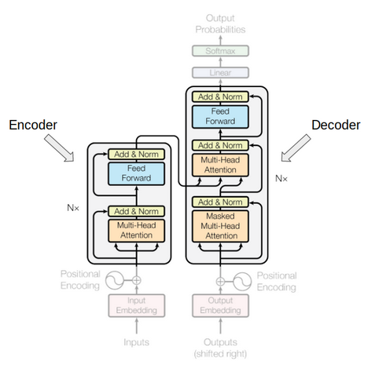
MODEL 5
Pre-trained DistilGPT2 Model
Dataset: Trained on the Entire Data Set ~About 48,000 rows of data Topology:
1/8 the size of GPT 2
6 decoder layers
Parameters:
Beam paths: 5
Temperature: 0.7
Top_k: 50
Top_p: 1
Generated text:
Aromatic nose combines blackberry, licorice, violet, menthol and wild herbs. Juicy, spicy and intense, with a restrained sweetness to the flavors of dark berries, licorice and bitter chocolate. Finishes with substantial tongue-clean

Slide 14
Model Performance – ‘Aromatic’ Seed
Model | Generated Text
Model 1 | Aromatic and beautiful harmonious with black tea notes that are in good harmony supported by light tannins and prominent acidity offers a beautiful mouthfeel that coats the palate and invites you back for another sip drink now through 2027 500 cases imported
Model 2 | Aromatic and fresh with a savory that underscores well defined and plush another show finish drink now through 2027 5
Model 3 | Placeholder
Model 4 | Aromatic and beautiful but the the the on good the and finishes dark and nose of a berry of offering with a to an by this palate
Model 5 | Aromatic nose combines blackberry, licorice, violet, menthol and wild herbs. Juicy, spicy and intense, with a restrained sweetness to the flavors of dark berries, licorice and bitter chocolate. Finishes with substantial tongue-clean

Slide 15
DistilGPT – Bleu & Rouge
Bleu and Rouge were both used as general metrics but both measure the exact words generated sample vs the ground truth
Only check for the same word, and not for synonyms
Bleu |  | Rouge 1
Cumulative 1-gram | 0.16 | F1 | 0.28
Cumulative 2-gram | 0.27 | Recall | 0.27
Cumulative 3-gram | 0.29 | Precision | 0.30
Cumulative 4-gram | 0.28

Slide 16
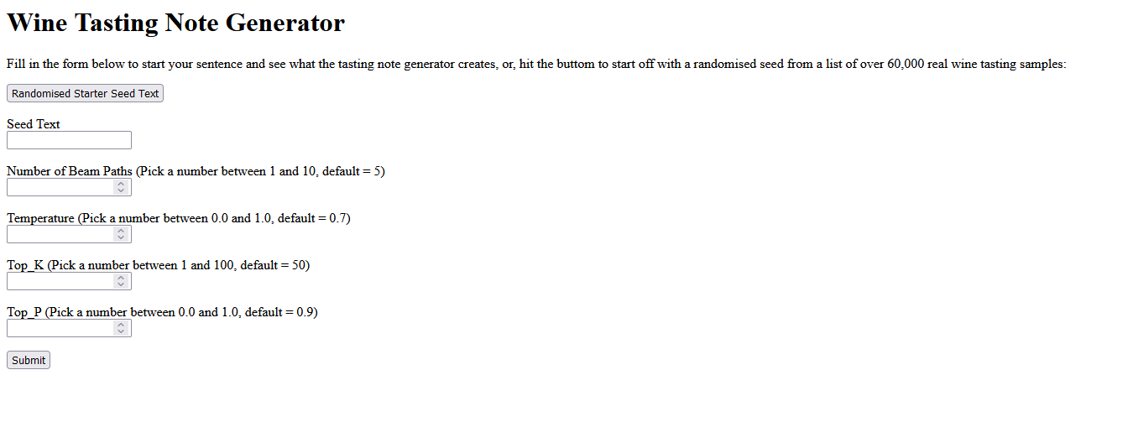
Flask API – Wine Note Generator

Slide 17
Conclusions
The simpler models seemed to perform better with LSTMs versus Multi-Attention Head in an encoder block
The number of dimensions initially assigned to the value of a word contributed heavily to the performance of the model but the number of dimensions rapidly made the model untenably large as well
In no instance, did any of my models perform better than the pre-trained GPT2 model, which is expected. DistilGPT2 was able to produce punctuation that was appropriate, as well as the most natural sounding wine tasting notes
None of the models worked perfectly with all of them encountering some issues

Slide 18
Further Upgrades
Controlled Text Generation
Unknown Words
Ideally, notes would be generated based on region and vintage
Pre-Weighting of the two values and their inclusion into the seed text might be one way to do this
Unknown words in the seed text are treated as unknown
A system could be made to reference a larger library like GPT large and pull the closest word in values to replace it in the sentence

Slide 19
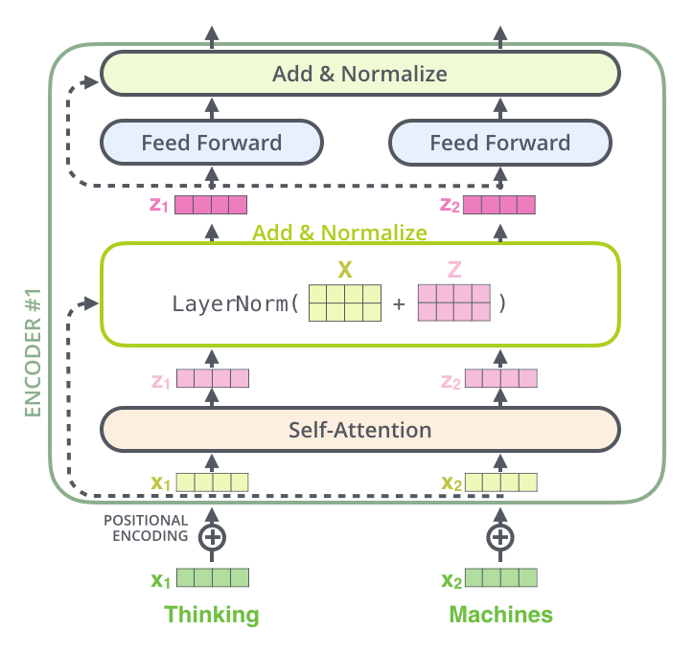
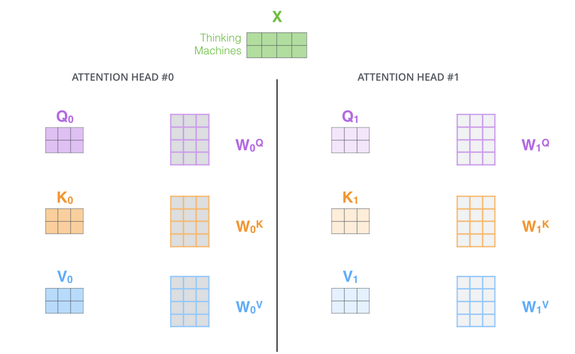
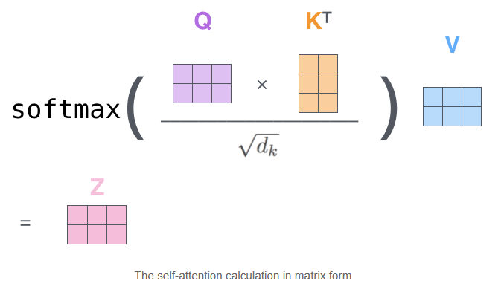
Appendix: Transformer Encoding Block
Multi-Head Attention
Input: ‘Thinking Machines’
Query, Key, Value

Slide 20
DANKE!
Habt ihr noch Fragen?
youremail@freepik.com
+39 620 421 838
yourcompany.com
Bitte lösche diese Folie nicht, es sei denn du bist ein Premium Nutzer

